Slide 1
CS 4530: Fundamentals of Software Engineering Module 7: React
Adeel Bhutta and Mitch Wand
Khoury College of Computer Sciences
© 2023 Released under the CC BY-SA license

Slide 2
Learning Objectives for this Lesson
By the end of this lesson, you should be able to:
Understand how the React framework binds data (and changes to it) to a UI
Create simple React components that use state and properties

Slide 3

HTML: The Markup Language of the Web
Language for describing structure of a document
Denotes hierarchy of elements
What might be elements in this document?
Notes:
HTML is the markup language of the Web.
It is a language for describing the structure of a document.
And it does so by denoting the hierarchy of elements in the document.
On the right, we see an article from a newspaper and an electronic version of it.
We can see that the article has a title, a subtitle, an image, and multiple paragraphs in it.
These are all elements that can be found in html.

Slide 4
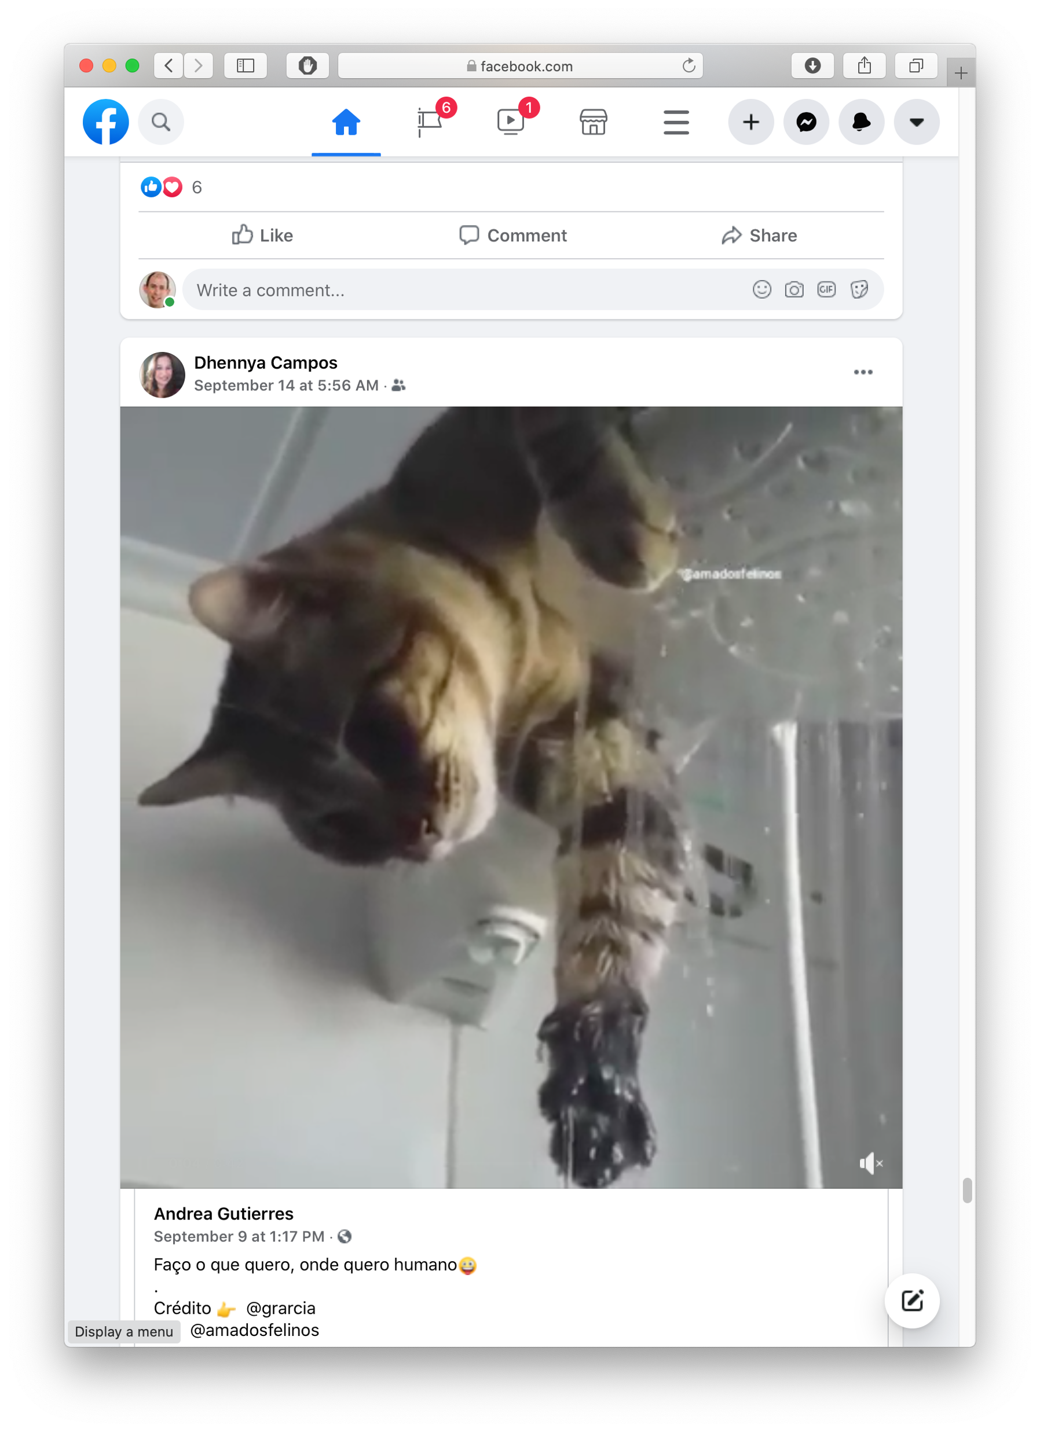

Rich, interactive web apps
Infinite scrolling of cats
Notes:
HTML only gives us only static web apps.
In order to build more complicated logic and add interactivity, we need to add JavaScript.
If we want to add much more complicated features a such as infinitely scrolling cats where the page automatically loads more data as we scroll, we would want something more than just JavaScript.
We need something which brings repeatability and structure to JavaScript, which will make development easy.
One framework for doing just that, is React, which we will look at in the further slides.

Slide 5

Typical properties of web app UIs
Each widget has both visual presentation & logic
Some widgets occur more than once
e.g., comment/like widgets
Changes to data should cause changes to widget
e.g., new images, new comments should show up in real time
Widgets have hierarchical structure
Action on a widget may affect other widgets
e.g., clicking on 'like' button executes some logic related to the widget itself,
It may also affect the widget the contains the ‘like’ button
Notes:
Before jumping straight into React, let us study some of the typical properties of web application Uis,
Interactive web apps are made up of widgets. A widget is an element with which a user interacts.
It has visual representation, as well as logic.
A widget might appear multiple times on a single page, such as the like and comment widget for each image.
And any changes to the data should update the widget.
Such as new images or comments showing up in real time.
For example, Clicking on a like button executes some logic related to it.
Logic and presentation of a widget are strongly coupled, but different widgets are loosely related.
But how do we build such widgets?

Slide 6
Components represent widgets in object-like style
Organize related logic and presentation into a single unit
Includes necessary state and the logic for updating this state
Includes presentation for rendering this state into HTML
Synchronizes state and visual presentation
Whenever state changes, HTML should be rendered again
Notes:
Components organize the logic and presentation into a single unit.
This includes the state, and the logic necessary to update the state.
And it also includes the presentation for rendering this state.
Components also synchronize the state with its presentation, meaning that whenever the state changes, this updated html is rendered to the screen.

Slide 7
Components Example: Like button component
What does the button keep track of?
Is it liked or not
What post this is associated with
What logic does the button have?
When changing like status, send update to server
How does the button look?
Filled in if liked, hollow if not
Notes:
Let's go a little deeper into components and understand the like button component in terms of the data and presentation it needs to manage.
So, what does the like button keep track of?
It tracks whether the post is liked or not,
And it keeps track of what post it is associated with.
What logic does this button have?
When the like status is changed, it sends an update to the server.
And how does it look?
It is filled in if the post is liked and is hollow if not.

Slide 8
Server side vs. client side
Where should template/component be instantiated?
Server-side frameworks: Template instantiated on server
Examples: JSP, ColdFusion, PHP, ASP.NET
Logic executes on server, generating HTML that is served to browser
Front-end framework: Template runs in web browser
Examples: React, Angular, Meteor, Ember, Aurelia, …
Server passes template to browser; browser generates HTML on demand
Notes:
There are a few design choices which need be made when building web applications.
One such choice is where the template or component should be instantiated?
Some frameworks prefer to compile the templates on the server and then send the html to the browser.
Such frameworks include JSP, cold fusion, PHP. This executes logic on the server.
Another approach could be to compile the html in the client’s browser and render the html.
Some frameworks which do this are React, Angular, Ember, and many more.
This executes logic in the browser and has lower latency.

Slide 9
Expressing Logic
Templates/components require combining logic with HTML
Conditionals - only display presentation if some expression is true
Loops - repeat this template once for every item in collection
How should this be expressed?
Embed code in HTML (ColdFusion, JSP, Angular)
Embed HTML in code (React)
Notes:
Another design choice is related to expressing logic
Templates or components require conditional rendering.
They may display some content only if the condition is true or might require loops to repeat the content.
How should this be expressed?
We can either do this by embedding code in HTML or embedding HTML in code..

Slide 10
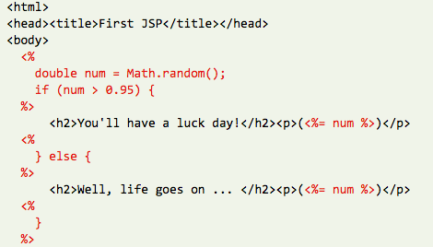
Embedding Code in HTML
Template takes the form of an HTML file, with extensions
Popular for server-side frameworks
Uses another language (e.g., Java, C) or custom language to express logic
Found in frameworks such as PHP, Angular, ColdFusion, ASP (NOT React)
Can’t type check anything
Notes:
When we embed code in html, the template takes the form of an HTML file with extensions.
This is quite popular for server-side rendering frameworks such as PHP, ColdFusion, and JSP.
This typically uses another language to express the logic, such as JAVA or C.
The main drawback is that the logic cannot be statically analyzed, and type checked.

Slide 11
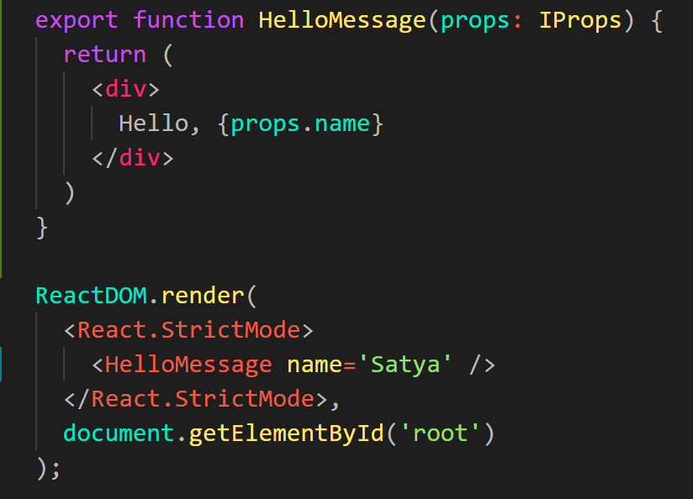
Embedding HTML in TypeScript Aka JSX or TSX
How do you embed HTML in TypeScript and get syntax checking?
Idea: extend the language: JSX, TSX
JavaScript (or TypeScript) language, with additional feature that expressions may be HTML
It’s a new language
Browsers do not natively run JSX (or TypeScript)
We use build tools that compile everything into JavaScript
Notes:
The second approach is the one taken by React, which is embedding html in Typescript/javascript.
But how do we do this?
We extend the language to include the additional features that we want.
This creates a new language called Reactive JS/TS with the extension jsx and tsx respectively.
Since this is a completely new language, the browsers do not run it natively.
We need to use some tools to compile the code to javascript.

Slide 12
JSX/TSX Embeds HTML in TypeScript
Example:
HTML embedded in TypeScript
HTML can be used as an expression
HTML is checked for correct syntax
Can use { expr } to evaluate an expression and return a value
e.g., { 5 + 2 }, { foo() }
To wrap on multiple lines, wrap the TSX/JSX in parentheses (…)
Value of expression is a piece of HTML
return <div>Hello {someVariable}</div>;
Notes:
As we know, React uses an extended syntax to include HTML in Typescript.
This allows us to use HTML as an expression in typescript.
An example of this is returning an html element instead of a value or variable.
This allows the html to be checked for correct syntax.
And within this html element, we can add expressions using the curly braces.
For example, writing 5 + 2 in the curly braces would print 7 in the html.
Similarly, calling the function foo() would evaluate the value that foo returns.
We can use this expression to bind data from our component to the html.

Slide 13
React is a Framework for Components
Created by Facebook
Powerful abstractions for describing UI components
Official documentation & tutorials: https://reactjs.org/
Components are constructed in the browser (“front-end”)
Key concepts:
Embed HTML in TypeScript
Track application “state”
Automatically and efficiently re-render page in browser based on changes to state
But: some implementations of React allow components to be pre-constructed in the server.
Notes:
And finally, we are going to talk about React!
React is a front end framework for building components.
It was created by Facebook in May of 2013.
It provides powerful abstractions for creating and describing components.
Some of the key concepts that we will cover include:
Embedding HTML in Typescript.
Tracking application state.
And how React automatically and efficiently re-renders parts of the page through a process called reconciliation.

Slide 14
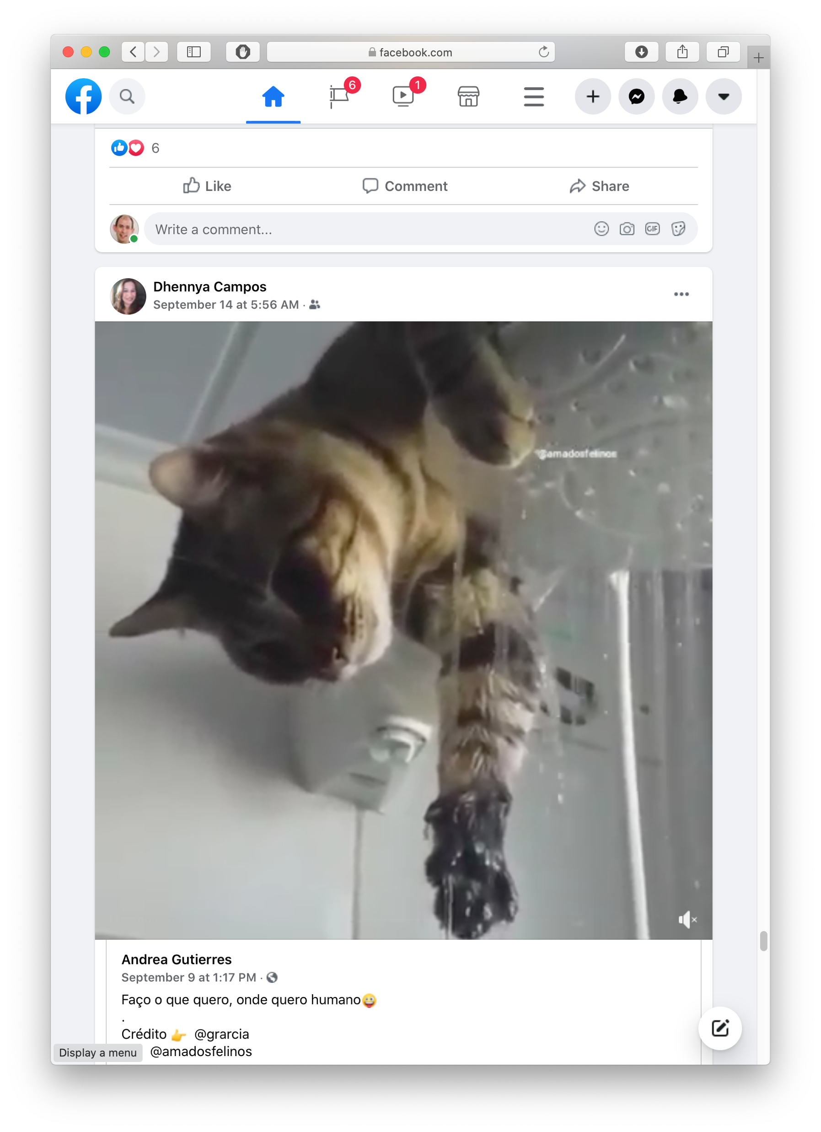

Rich, interactive web apps Infinite scrolling of cats
Built with React
Plus, AirBNB, Uber, Pinterest,
Netflix, Twitter and 8855 more
Notes:
React is and has been among the most popular frameworks for front end development for the past few years.
A lot of applications that we use everyday use React.
Some of these include Facebook, Instagram, AirBNB, Netflix and Twitter.

Slide 15
Creating React applications
A React application is a complicated beast.
There are several popular frameworks for building such an application
The one we will use is called next.js .
It is a full-featured framework; we will use only a small fraction of its features.

Slide 16
Creating New React Applications
React applications must be “transpiled” into a format that browsers can understand
create-next-app is a set of scripts to automate this all
npx create-next-app starts an interactive session that creates a fully-featured TS package
Probably you will never do this in this course– the “fully-featured TS package” is a big beast.
Better plan is to modify one of the packages that we supply you.

Slide 17
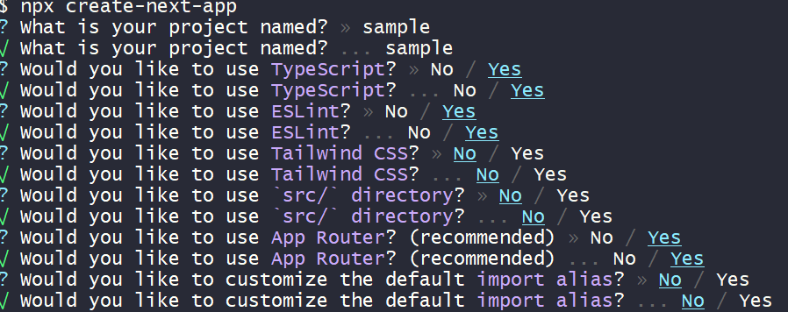
Here’s a sample interaction…
Notes:
Except for your project name, the defaults are pretty good. The project name must be “html friendly”– no capital letters or punctuation except for “-”. Once the project is created, you can name the directory it’s in to whatever you want.

Slide 18
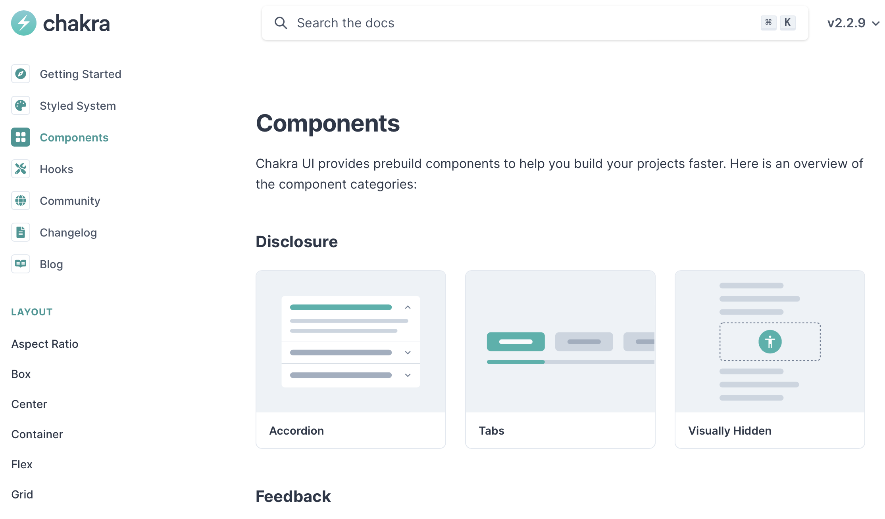
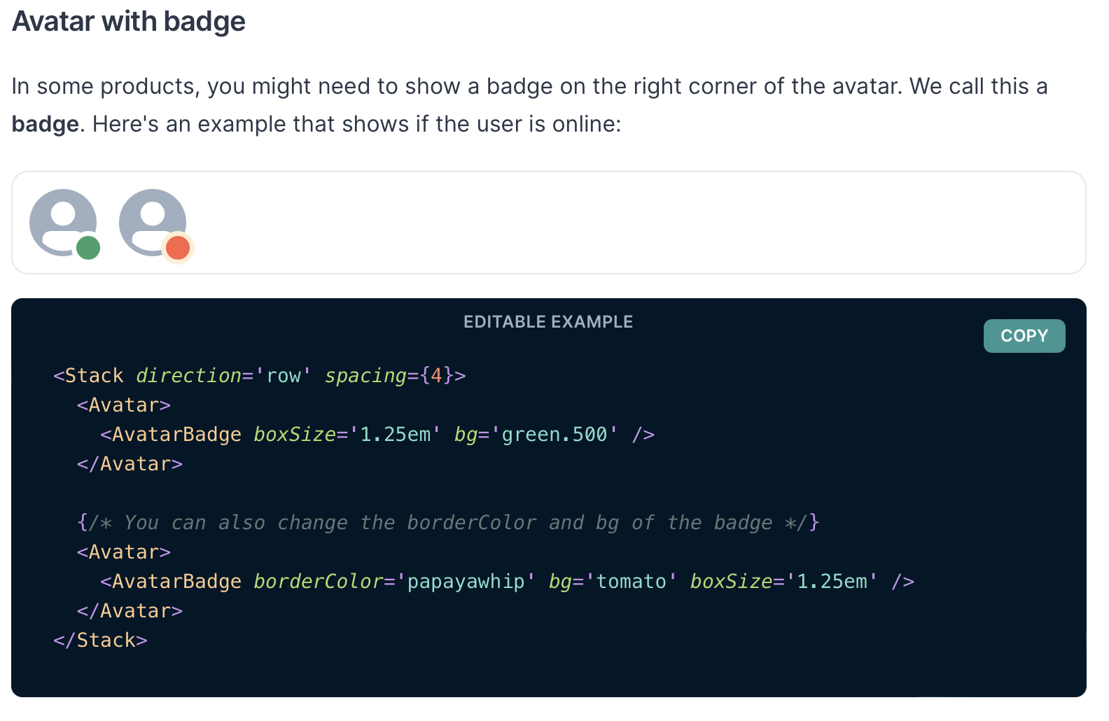
React Has a Rich Component Library
Notes:
Part of the idea with components is that they can be easily packaged up, shared, and reused. A few slides ago, we saw an example of one: the IconButton, and the heart icon. These components come from a popular React component library called Chakra UI. The Chakra UI web page lists all of the components in the library, and we show another example component on the right - the avatar component.
We like Chakra UI because it was built from the ground up to be compliant with web accessibility standards - it is possible to make accessible application using other frameworks, too, but starting with accessibility in mind is a good practice to ensure that you do not inadvertently create something that is challenging to adapt.
Other popular component libraries include Material UI and ANT Design.

Slide 19
Installing Chakra for next.js:
Just say:
npm i -–save @chakra-ui/react @chakra-ui/next-js \
@emotion/react @emotion/styled framer-motion

Slide 20
Hello World in React
app/Apps/HelloWorld.tsx
import * as React from 'react';
import {
Heading,
VStack
} from '@chakra-ui/react';
function HelloWorldComponent() {
return (
<VStack>
<Heading>Hello World</Heading>
</VStack>
)
}
export default function App() {
return (<HelloWorldComponent />)
}
“Return the following HTML whenever the component is rendered”
The HTML is dynamically generated by the library.
Notes:
Here we’ve defined a “Hello World” component The name must begin with a capital letter and it must return some html. Here’s we’ve returned some styled html using the Chakra UI library.
This component contains no logic or data and returns the same html every time.
Export your app as the default function (the name you give it doesn’t matter); the React system will render it on the screen.
<Demo>

Slide 21
Next.js renders whatever is in app/page.tsx
app/page.tsx
import App from './Apps/HelloWorld'
// import App from './Apps/HelloWorldDave'
// import App from './Apps/App1';
export default function HomePage() {
return (
<ChakraProvider>
<App />
</ChakraProvider>
)
}
Notes:
Here is the file pages.tsx in the package’s app directory.
I’ve set it up to import apps from a set of other files in the package. This is way simpler than the default version of this file that you get from next.js.
Next.js will run whatever component is the default export component from app/page.tsx .

Slide 22
You may see “Class” components, too – but we won’t write them
var HelloMessage = React.createClass({
render: function() {
return <div>Hello, World!</div>
}
})
export function HelloMessage(){
return <div>Hello, World!</div>
}
Hello World, Circa 2016
(Before the “Class” keyword!)
class HelloMessage extends React.Component {
render(){
return <div>Hello, World!</div>
}
}
Hello World, Circa 2022 (Defined as a function)
Hello World, Circa 2020 (Defined as a Class)
Notes:
Before we go too much deeper into React, we will have a brief sidebar to point out that React is a mature framework that has evolved over the past decade (since 2013). It has undergone several major changes, and it is worthwhile to be able to recognize components that are written in these historical styles. The biggest change that React has undergone has been the migration from class-based components to functional components. On this slide, we show variants of the “hello world” component (taken from actual slides that Prof Bell has used over the years). While we are not yet at the point where writing components as classes is “wrong”, it is strongly discouraged, and for the purposes of this class, it is prohibited. In the next lecture, we’ll expand on the patterns that have grown around React to support functional components: the migration is driven by a need for a structure that has better modularity.

Slide 23
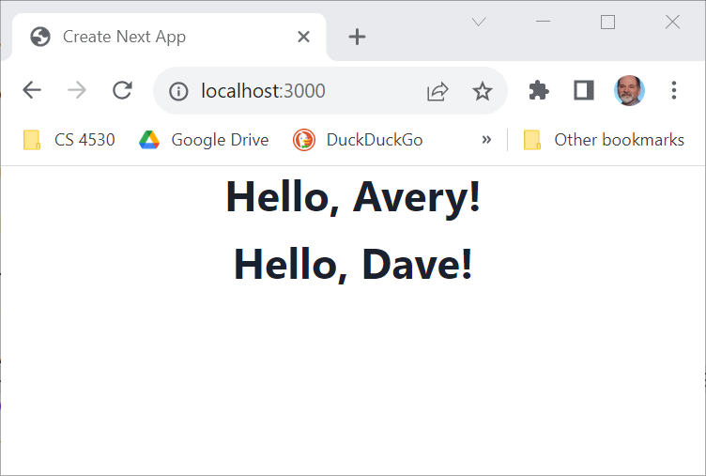
React Components Can Receive Properties.
Properties are passed in an argument to the component
Properties are specified as attributes when the component is instantiated
Properties can not be changed by the component
export default function App() {
return (<VStack>
<HelloWorldWithName name='Avery'/>
<HelloWorldWithName name='Dave'/>
</VStack>
)
}
Notes:
(Read slide)
The screenshot on the right shows what appears in the browser when this code renders.
It is difficult to imagine how we can construct rich, dynamic web applications using just components with properties: since properties can’t be changed, it is difficult to have dynamic behavior.
In React, our name for data that can change is “state”

Slide 24
Component State is Data That Changes
State is data that, when changed, should trigger UI update
State is created by useState.
The state is accessed through state variables in the component.
The first variable is the accessor, the second is the setter.
The only way to change the value of a state variable is with the setter
import { useState } from 'react';
function Foo() {
const [count, setCount] = useState(0)
….
}
You could choose any names for the variable and its setter; for this class, please follow the naming convention (goodVariableNlame, setGoodVariablename) that we’e used here.
Notes:
“State” is component data that changes. It is important to distinguish data that doesn’t change from data that does change because changes to data should result in the component re-rendering. That is, when the data changes, we want our component to “react” to the change visually.
With React, we define state variables by calling the special method “useState”. `useState` takes a single parameter, which defines the default value of the state.
It returns an array with two elements: the first element is the value of the state variable, and the second is a setter which is used to change the state variable - the code on line 2 is typescript shorthand for saying: “declare a variable `count`, and set it to the first element of the array returned by useState, and declare another variable `setCount`, and set it to the second element in that array”
All updates to state must be made through the setter function.
React doesn’t care what names you choose for these variables; however for this class, we care that you choose a good variable name (as covered in our general design principles), and call the setter “setGoodVariableName”

Slide 25
Example
app/Apps/SimplestState.tsx
export default function App() {
const [count, setCount] = useState(0)
function handleClick() { setCount(count + 1) }
return (
<VStack>
<Box> count = {count} </Box>
<Button onClick={handleClick} >
Increment Count!
</Button>
</VStack>
)
}
(Some styling has been removed to reduce clutter on this screen.}
Notes:
When the user clicks on a button, the button’s onClick property is called. Here the onClick property is the function handleClick, which invokes the setCount function.
<Demo>
This is a simple example of the pattern: Pass handlers down as props.

Slide 26
Setters are asynchronous
app/Apps/SimplestStateWithConsole.tsx
A setter doesn’t change the state immediately: it tells REACT to update the state when this component is redisplayed.
function handleClick() {
console.error('Button pressed!');
console.log('before setCount: count = ', count)
setCount(count + 1)
console.log('after setCount: count = ', count)
}
Console methods: https://developer.mozilla.org/en-US/docs/Web/API/console
Notes:
Setters don’t change the state immediately: they tell REACT to update the state when this component is redisplayed.
Here’s another version of `handleClick` where we’ve added some logging. The `console.error` just displays its message with a red background– this is handy if you have many messages on the console and you want to highlight one of them. (There are actually a bunch of things you can do to organize your console messages– see the link on the slide)

Slide 27
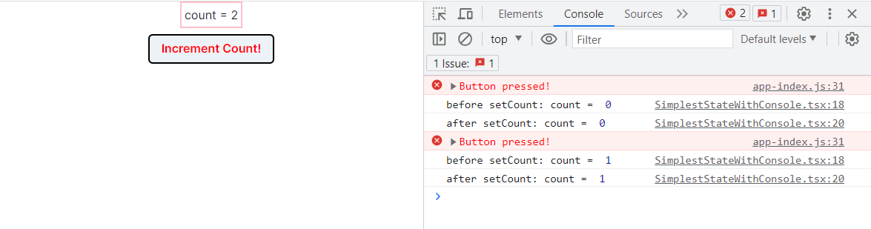
Setters are asynchronous
app/Apps/SimplestStateWithConsole.tsx
function handleClick() {
console.error('Button pressed!');
console.log('before setCount: count = ', count)
setCount(count + 1)
console.log('after setCount: count = ', count)
}
Notes:
Let’s see what happens when we run this
<click>
Here we’ve opened the console, by hitting Control-Shift-I, select ‘Console’, and set the level to ‘default’.
Then we clicked the button twice.
Observe that immediately after the first setCount, the value of count is still 0; similarly, the value of count is still 1 after the second setCount.
That's because, as we said, Setters don’t change the state immediately: they tell REACT to update the state when this component is redisplayed.
So when it did the console.log, the value of count was unchanged. But after the redisplay, the value is correctly updated, which you can see on the left.
<Demo this>

Slide 28
Nest Components, Passing State as Properties
app/Apps/TwoCountingButtons.tsx
A common pattern in React is to nest components, passing information from parent to child via props.
import { CountingButton } from './CountingButton';
export default function App() {
const [globalCount, setGlobalCount] = useState(0)
function handleClick() {setGlobalCount(globalCount + 1)}
return (
<VStack>
<Box border="1px" padding='1'>Total count = {globalCount}</Box>
<Box h="20px" />
<CountingButton name="Button A" onClick={handleClick} />
<Box h="20px" />
<CountingButton name="Button B" onClick={handleClick} />
</VStack>
)}
Notes:
Let’s move on to how components can communicate with each other.
A common pattern is to nest components, passing values “down” from parents to children as props.
Here is an app that creates two CountingButtons, similar to what we had in the previous example. It passes to each of them a name, and the handler it should use when it is clicked. The intention is that when the button is clicked, it should call handleClick, which will increment the state variable globalCount.
<Demo>
Exercise: modify this example so that each counting button also displays the global count.

Slide 29
CountingButton.tsx
app/Apps/CountingButton.tsx
export function CountingButton(props: {
name:string, onClick:() => void }) {
const name = props.name
const [localCount, setLocalCount] = useState(0)
function handleClick() {
console.error(props.name, 'pressed!');
setLocalCount(localCount + 1)
props.onClick() // propagate to parent
}
return (
<VStack>
<Box>
count for {props.name} = {localCount}
</Box>
<Button onClick={handleClick}>
Increment {name}!
</Button>
</VStack>
)
}
(Some styling has been removed to reduce clutter on this screen.}
Notes:
Here’s the definition of CountingButton. The key bit of code is highlighted in yellow.

Slide 30
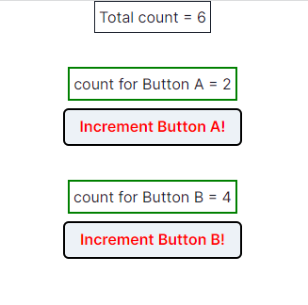
TwoCountingButtons demo
Notes:
<Possible live demo here>
Observe that pushing button A increments its own count, and also updates the total count. And similarly for button B.

Slide 31
A ToDo App
app/Apps/ToDoApp.tsx
export default function ToDoApp () {
const [todoList,setTodolist] = useState<TodoItem[]>([]) function handleAdd (newItem:TodoItem) {
if (newItem.title === '') {return} // ignore blank button presses
setTodolist(todoList.concat(newItem))
} function handleDelete(targetId:string) {
const newList = todoList.filter(item => item.id != targetId)
setTodolist(newList)
}
return (
<VStack>
<Heading>TODO List</Heading>
<ToDoItemEntryForm onAdd={handleAdd}/>
<ToDoListDisplay items={todoList} onDelete={handleDelete}/>
</VStack>
)
}
Notes:
To illustrate another important pattern in React, let’s look at a ToDoApp. Here the master component keeps a list of todo items, and it has functions for handling a new item (coming from ToDoItemEntryForm), and for handling a deletion (coming from ToDoListDisplay).
Let’s look at this in action….

Slide 32
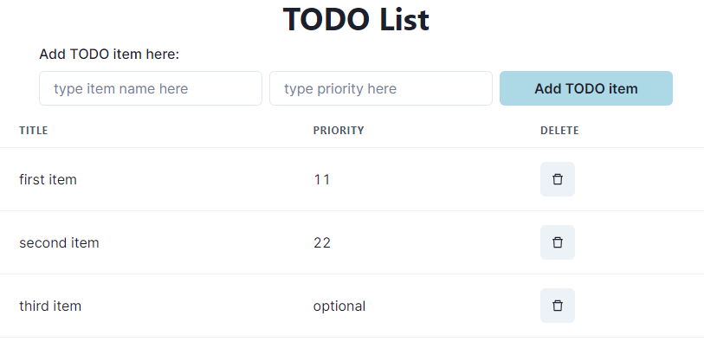
Typical Page
Notes:
As usual, we’ve used a minimum of styling.
<Do a demo, including adding items and deleting from the middle of the list>

Slide 33
Pattern: display a list of items using map
export function ToDoListDisplay(props: { items: ToDoItem[],
onDelete:(id:string) => void })
return (
<Table>
<Tbody>
{
props.items.map((eachItem) =>
<ToDoItemDisplay item={eachItem}
key={eachItem.id}
onDelete={props.onDelete} />)
}
</Tbody>
</Table>
)
}
Notes:
In our previous examples, our parent component had a fixed number of children (in our case, two)
But in the todo list, the parent has to display a component for each item. We don’t know in advance how many there are, and the number may change dynamically, as we saw in the demo.
The solution to the problem is to use map. Evaluating the map gives a nice list of components, which are here displayed vertically (since they are rows in a table).

Slide 34
But using map comes with a big gotcha.
export function ToDoListDisplay(props: { items: ToDoItem[],
onDelete:(id:string) => void })
return (
<Table>
<Tbody>
{
props.items.map((eachItem) =>
<ToDoItemDisplay item={eachItem}
key={eachItem.id}
onDelete={props.onDelete} />)
}
</Tbody>
</Table>
)
}
Notes:
When you use map to display a list of items, each item must have a property that uniquely identifies it, and it must be called key. Otherwise, when REACT goes to redisplay the list, it doesn't know which elements are new and which are kept from the previous display.
Sometimes React will give you an error if you don’t pass a `key` attribute; sometimes it will just do strange wrong things. For example, if you delete an element and immediately add a new one, it will get confused. On the next slide, we'll look at a brief example of this undesired behavior

Slide 35
The key attribute must be unique and stable.
This doesn’t work:
props.items.map((eachItem,index) =>
<ToDoItemDisplay item={eachItem} key={index.toString()} onDelete={props.onDelete} />
)
Notes:
Here we’ve given React a key that is unique across the map, but is not stable: if we delete an element from the `items` array, all the elements after the deleted one will move up one position.
<Demo: in ToDoApp.tsx, import ToDoListDisplay from ToDoListDisplayBad.tsx instead of from ToDoListDisplay.tsx; add some items, then remove one from the middle.>
This illustrates what can happen if you don't use the key attribute properly. If items appear to be mysteriously appearing or disappearing from your list, keep this in mind as a likely bug in your code.

Slide 36
Summarizing React Behavior
React uses default state for the first render of our component.
When setter is called, React asynchronously re-renders our component and updates the state variable.
Updating the DOM in the browser is slow - it is vital that React does efficient diff’ing
Example: adding a new comment on a YouTube video shouldn’t make the browser re-layout the whole page
React makes re-rendering faster by updating only the part that changes.
This is called “Reconciliation”
It uses some magic like keeping track of state of each component (e.g., second component was liked)
Keys are necessary for correct re-rendering of lists. These should be unique and stable (don’t change with each update)
Notes:
(Read slide)

Slide 37
Review
Now that you've studied this lesson, you should be able to:
Understand how the React framework binds data (and changes to it) to a UI
Create simple React components that use state and properties
The next lesson will do a deep dive on patterns of React, including useState and its friend, useEffect

